Slide 1

GxP Prime
Track: Healthcare
Use Case: Compliance & Regulations

Slide 2
















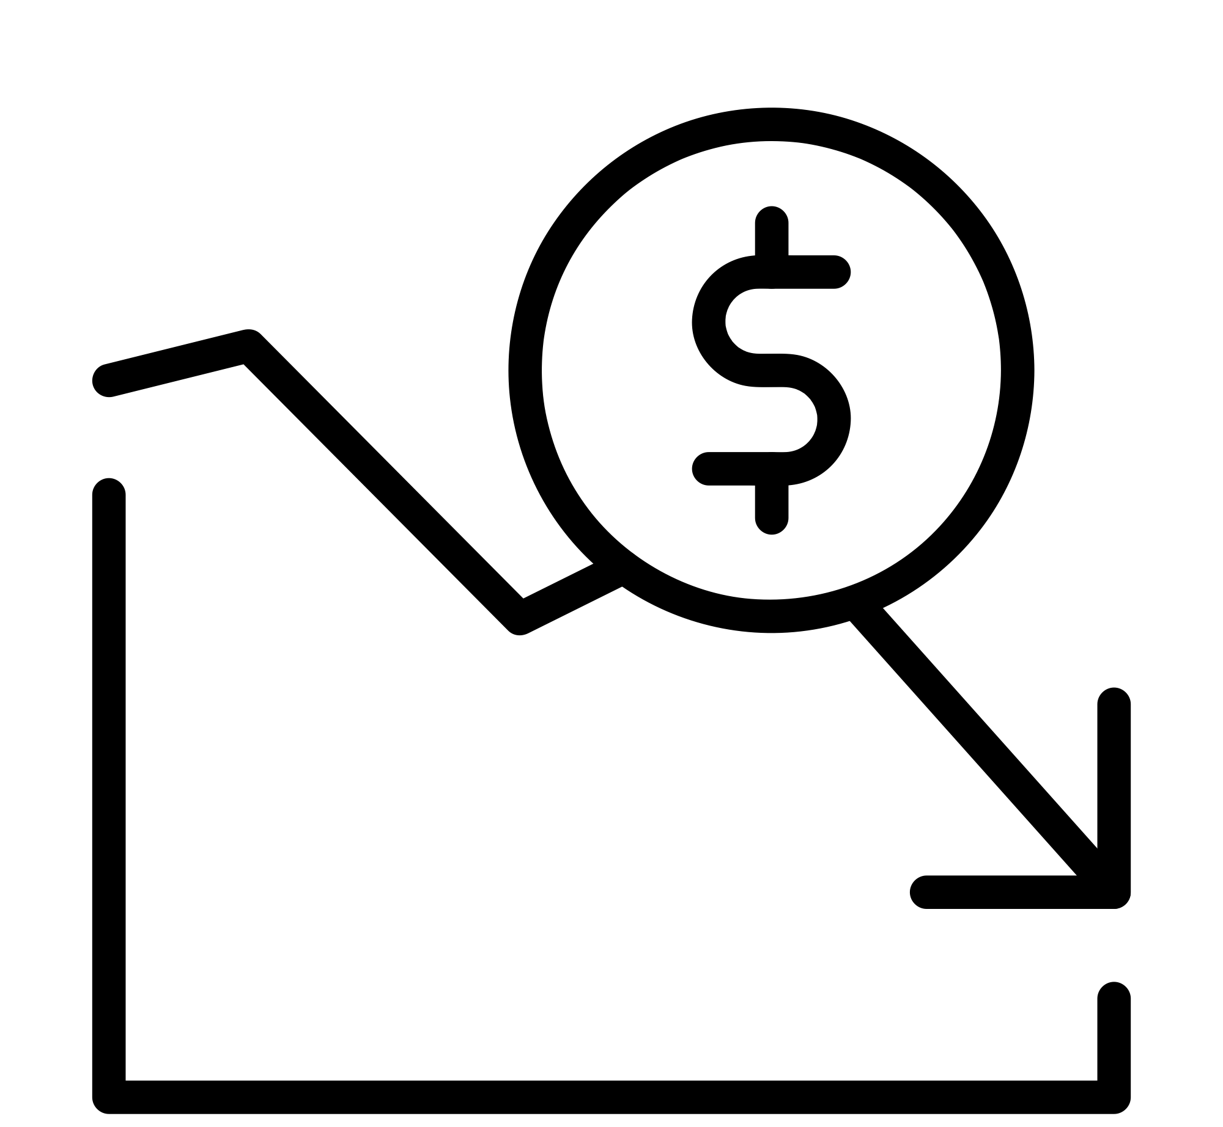




Proposed Solution
2005
GxP?
How? When? Where? Who
#@&!!!
Introducing CT-X500
FDA
10yrs later
. . .
>
Scenario 1:
Scenario 2:
GxP?
How? When? Where? Who
FDA
overtime
2018
Introducing CT-2500x

Slide 3
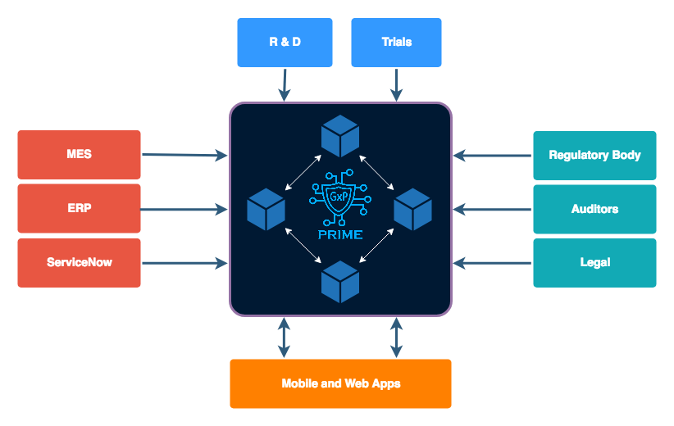
Tech Architecture

Slide 4
Product Demo
Prototype/Demo/Walkthrough
https://youtu.be/wnBSoYxfh4s

Slide 5
Summary
Value Add?
~60% reduction in auditing expenses
100% coverage of clinical trials
Safer health products
Secure position in the market
Goals
Platform for integration with enterprise systems
Process Agnostic platform for process logs
Regulatory bodies as participants in the BN
Multi-org network with vendors manufacturers and maintainers
Tactical Milestones
M1
M2
M3
M4
Audit log platform for healthcare manufacturing PoC
Audit Log platform agnostic to process and industry
Multi-org network for end-end audit trails
Blockchain as final source of truth for all regulatory bodies

